Slide 1
High-Performance Encryption (HPE)
ACE Solutions Architecture Team

Slide 2






Zero Trust – Datapath Encryption
Why?
Compliance Requirement
Data Security
Business Policy
Native Constructs Routing Scalability Challenges
Aviatrix Datapath Encryption
UNTRUSTED
Datapath Encryption = Maybe
Application Encryption = Maybe
Public
Cloud
Azure Express Route
Aviatrix Datapath Encryption
UNTRUSTED
AWS Direct Connect
Data Center
TRUSTED LAN
2

Slide 3

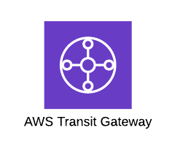

Without Aviatrix: Encryption / IPsec Performance Limitations
Packet can only use single core despite availability of multiple cores
All software-based IPsec VPN solutions have maximum performance of 2Gbps depending on ciphers used
Software Routers use single core and establish only one tunnel
UDP/ESP
Traditional Tunnel
Encryption/Decryption
vCPU
vCPU
~ 1.25 Gbps
vCPU
vCPU
Encryption/Decryption
vCPU
vCPU
vCPU
vCPU
3rd party router firewall
Azure
VPN GW

Slide 4

Solution: Aviatrix High Performance Encryption (HPE)
Aviatrix Controller automatically builds multiple tunnels between Aviatrix devices
Uses all available CPU cores
IPsec encryption performance can be up to 90 Gbps
High Performance Encryption
Aviatrix
Transit or
Spoke GW
Aviatrix
Transit or
Spoke GW
UDP/ESP
High Performance N x Tunnels
vCPU
vCPU
Up to 90 Gbps
vCPU
vCPU
Encryption/Decryption
Encryption/Decryption
Aviatrix
Edge 2.0
vCPU
vCPU
vCPU
vCPU
Aviatrix
Transit GW
High Performance Encryption is also called INSANE MODE

Slide 5
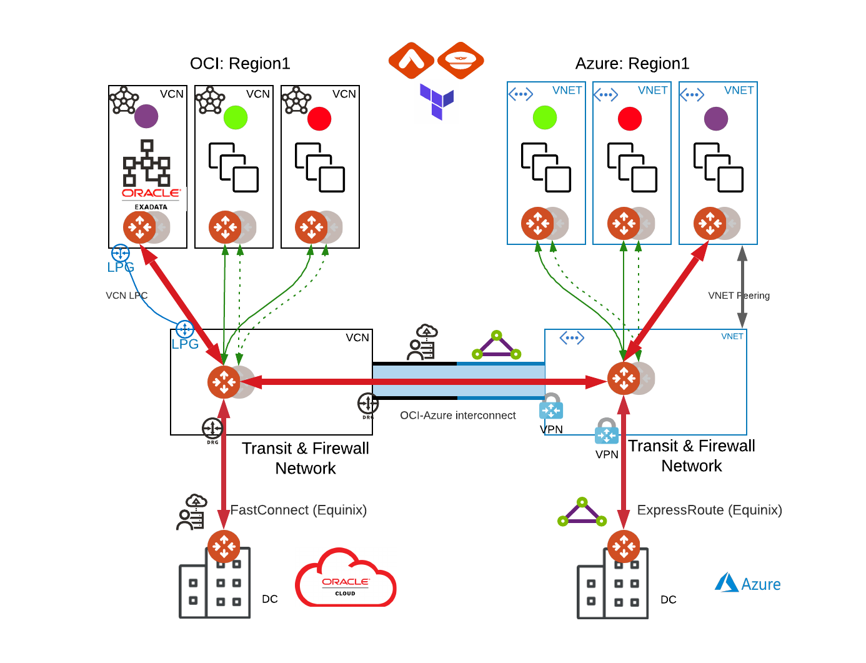
High Performance Encryption (HPE)
Between the Cloud (over DirectConnect, ExpressRoute, FastConnect, Cloud Interconnect) to the DC via:
Aviatrix Edge
Between networks in one cloud (same or different regions)
Automatic VPC/VNet/VCN peering to build required underlay
Between networks in different clouds
Requires private underlay (e.g., Equinix, Epsilon, OCI-Azure Interconnect)
Over Public Internet (v6.4)
Aviatrix Edge
Aviatrix Edge
Aviatrix Edge will be discussed in Site2Cloud module

Slide 6
HPE Peering – Public or Private IP?
HPE in the same cloud
Will use CSP-native peering so the tunnels will be built over private IPs.
HPE across different clouds
Supported over private circuits (Direct Connect, Express Route, Cloud Interconnect, Fast Connect).
Supported over internet (AWS, Azure, GCP, OCI).
6

Slide 7
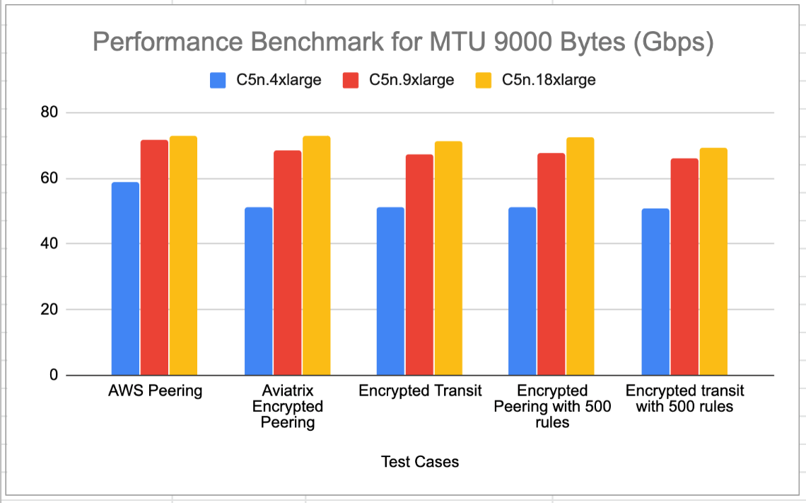
HPE Performance – Matching the Speed of the Underlay
https://docs.aviatrix.com/HowTos/insane_mode_perf.html
~90 Gbps in-region in AWS
9000 MTU supported
Line-Rate (~9.6 Gbps) over single 10 Gbps Direct Connect or ExpressRoute
7

Slide 8



Architecture over Direct Connect and Other Private Circuits
https://docs.aviatrix.com/HowTos/CloudN_insane_mode.html
Transit VPC
BGP/IPsec
VGW
BGP/IPsec
DX
DX
R1
R2
subnet2
WAN
WAN
Aviatrix Edge
LAN
LAN
BGP
BGP
subnet1
R3
R4
8

Slide 9






Aviatrix Edge GW for DC – Supported platforms
Aviatrix Edge GW
Aviatrix Edge
Aviatrix Edge
Aviatrix Edge
Customer managed
Edge CSP
Aviatrix Edge OS
OS Layer
HYPERVISOR
Customer managed
Aviatrix Managed
x86 Hardware
Customer’s Edge compute
x86 Hardware
Customer’s Edge compute
x86 Hardware
Aviatrix recommended HW
HARDWARE
HARDWARE
vCenter Server
Managed separately
E.g., Openstack
Managed separately
Aviatrix Edge platform

Slide 10
Next: ActiveMesh

